Slide 1

HOSPITAL PATIENT ANALYSIS

Slide 2

ABOUT
  It enables performance monitoring through indicators such as occupancy rate, patient volume, and average length of stay.
  The dataset captures operational and clinical information related to patient admissions, discharges, and treatments.
  The data set includes demographic details like age and gender
  The dataset serves as the foundation for interactive BI dashboards and executive reporting

Slide 3
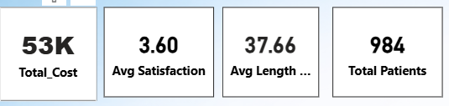
Cards - Healthcare Performance – Key Metrics Overview
The dashboard highlights four critical KPIs for healthcare monitoring.
Total Cost (53K) reflects the overall expenditure, useful for budgeting and financial analysis.
Average Satisfaction (3.60) indicates patient feedback levels, guiding service quality improvements.
Average Length of Stay (7.66) measures hospital efficiency and patient management.
Total Patients (984) shows patient volume, helping track workload and healthcare demand.

Slide 4
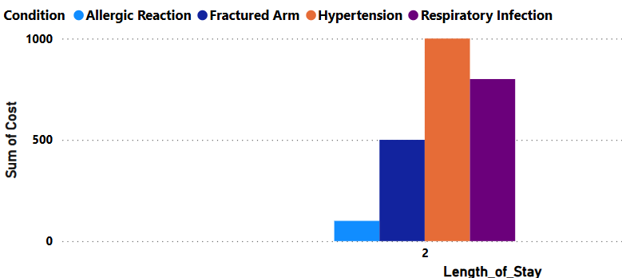
Clustered Column Chart – Sum of Cost by length of stay and Condition
This chart shows the total treatment cost for different medical conditions based on the length of stay.
We can see that Hypertension has the highest total cost, followed by Respiratory Infection and Fractured Arm.
Allergic Reaction has the lowest cost among the conditions.
The visual helps hospital management understand which conditions require more spending and better resource planning

Slide 5
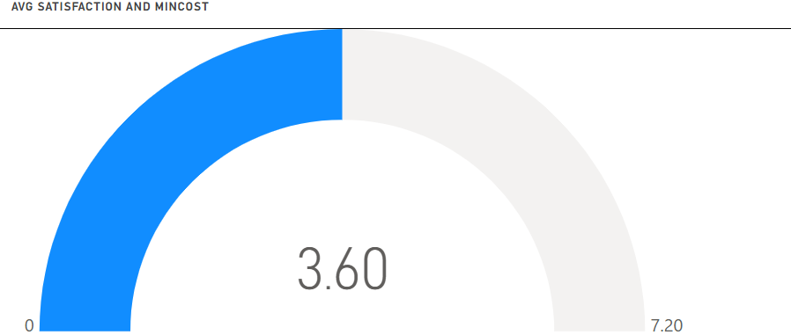
Gauge Chart – Avg Satisfaction and Min cost
  Score Shown: The chart shows a value of 3.60 for average satisfaction and minimum cost.
  Scale Range: It runs from 0 to 7.20, so 3.60 is right in the middle.
  Visual Highlight: The blue arc makes it easy to see the current level at a glance.
  A mid range score suggests moderate satisfaction with balanced cost efficiency .

Slide 6
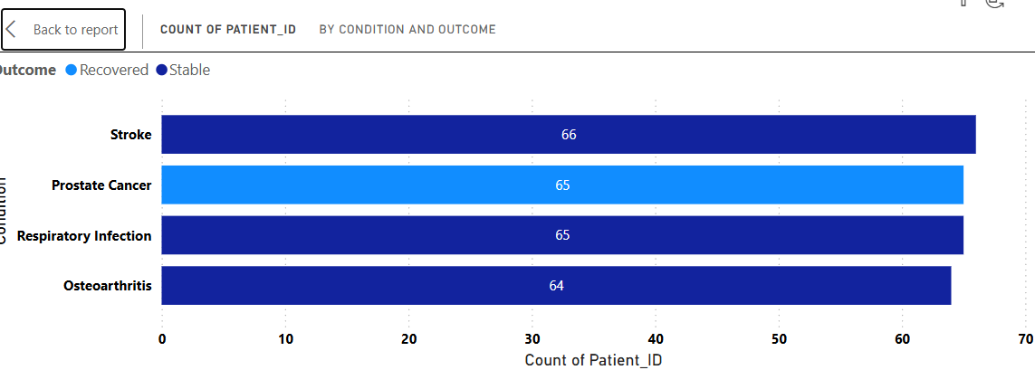
Clustered Column Chart – Count of Patient _ID by Condition and Outcome
Conditions Compared: The chart shows patient counts for Stroke, Prostate Cancer, Respiratory Infection, and Osteoarthritis.
Outcomes Shown: Patients are grouped into Recovered (light blue) and Stable (dark blue).
Stroke has the highest stable count (66), while Prostate Cancer has the highest recovered count (65).
Most conditions lean toward patients being stable, with recovery standing out mainly in Prostate Cancer.

Slide 7
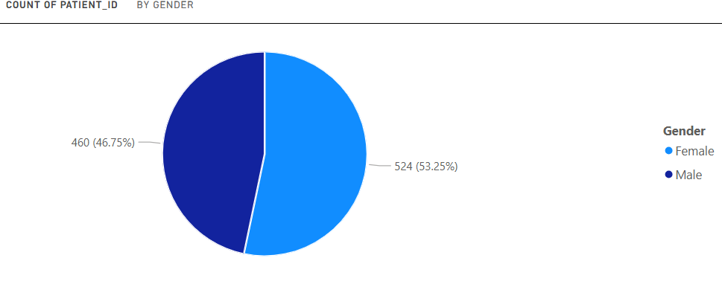
Pie Chart – Count of Patient _ID by Gender
This chart is about the count of patients by gender, showing how many are male and female.
Female Patients: There are 524 females, which is 53.25% of the total.
Male Patients: There are 460 males, making up 46.75% of the total.
The patient group is almost balanced, but females form a slight majority.

Slide 8
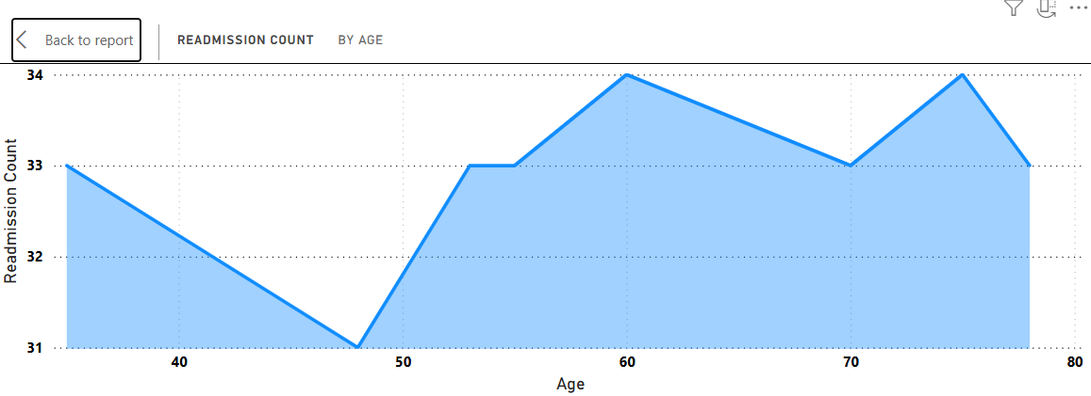
Area Chart – Readmission Count by Age
This chart is about the readmission count by age, showing how hospital readmissions change across age groups.
Fluctuating Trend: The counts move between 31 and 34 as age increases from 40 to 80.
Lowest at age 50 (31), highest at ages 60 and 70 (34), then back to 33 at age 80.
Readmission rates are not constant—they rise and fall slightly with age, peaking around 60–70 years.

Slide 9
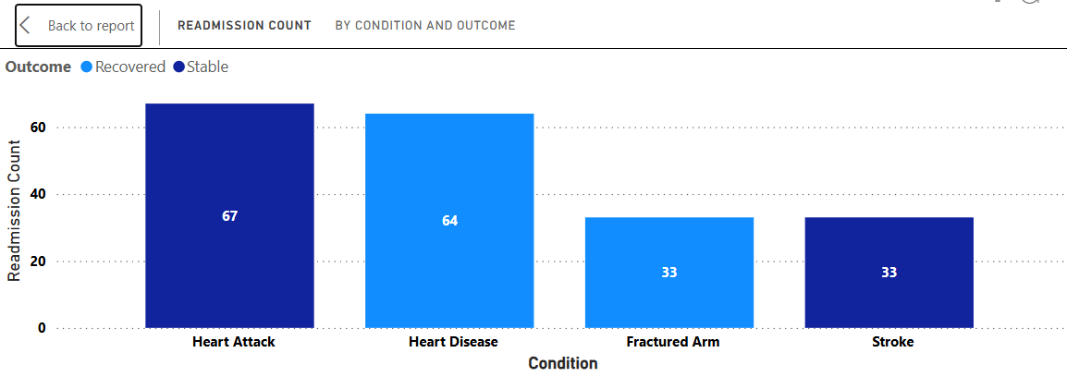
Stacked Column Chart – Readmission Count by Condition and Outcome
This chart is about the readmission count by condition and outcome, comparing different medical cases.
Heart Attack: Highest readmissions with 67 patients, mostly in the Stable outcome.
Heart Disease: Shows 64 readmissions, mainly in the Recovered category.
Fractured Arm & Stroke: Both have 33 readmissions each, with Fractured Arm in Recovered and Stroke in Stable.
Serious conditions like Heart Attack and Heart Disease have higher readmission counts, while less severe cases show lower numbers

Slide 10
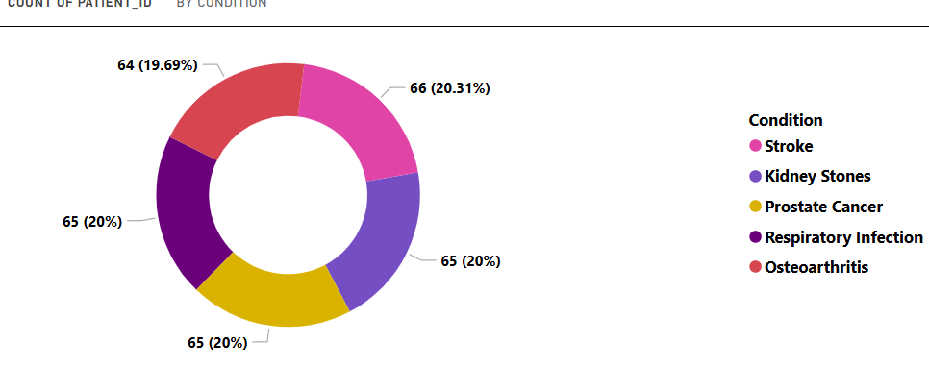
Donut Chart – Count of Patient _ID by Condition
This chart is about the count of patients by medical condition, showing how patients are distributed across five conditions.
Stroke: Highest count with 66 patients (20.31%).
Kidney Stones, Prostate Cancer, Respiratory Infection: Each has 65 patients (20%), showing nearly equal distribution.
Osteoarthritis: Slightly lower with 64 patients (19.69%).
The patient counts are almost evenly spread across all conditions, with only small differences.

Slide 11
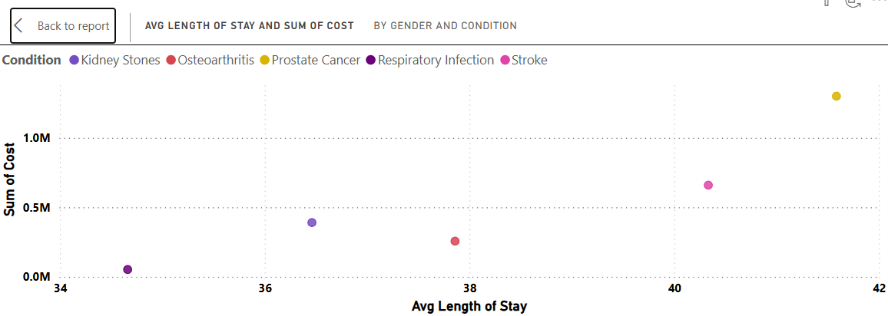
Scatter plot – Avg length of Stay and Sum _of Cost by Gender and Condition
Prostate Cancer: Has the highest cost and longest average stay, making it the most resource-intensive condition.
Kidney Stones: Show the lowest cost and shortest stay, indicating minimal resource use.
Other Conditions: Stroke, Osteoarthritis, and Respiratory Infection fall in between, with moderate costs and stay lengths.
The chart highlights how different conditions impact hospital resources differently, with some requiring longer stays and higher costs.

Slide 12
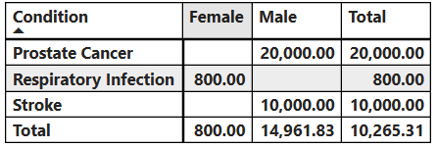
Matrix - Avg Cost by Condition and Gender
This chart is about the medical costs for different conditions, split by male and female patients.
Prostate Cancer: Shows a cost of 20,000, contributed only by male patients.
Respiratory Infection: Has a small cost of 800, coming only from female patients.
Stroke Adds 10,000, again from male patients.
Costs are highest for Prostate Cancer and Stroke, while Respiratory Infection is minimal.

Slide 13
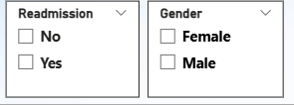
Slicer - Patient Data Entry – Readmission & Gender Selection
The interface displays two dropdown selection boxes designed for categorical data entry.
The first box captures patient readmission status, with options "Yes" or "No."
The second box records gender information, offering "Male" and "Female" choices
This setup ensures standardized data collection for healthcare analysis and reporting.
Such categorical inputs are commonly used in medical dashboards, patient records, and statistical studies to streamline data entry and maintain consistency.

Slide 14

THANK YOU

